Slide 1

Seminar-DETR Series
马鸣霄
2025.01.03

Slide 2
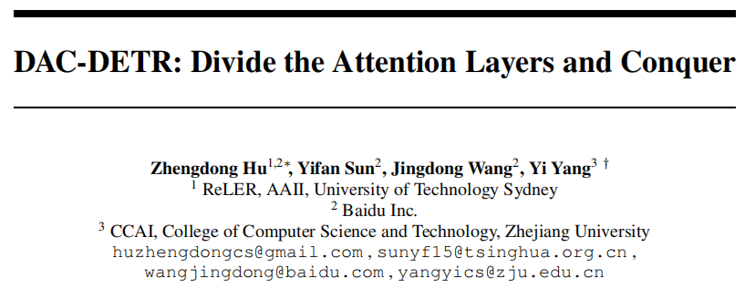
DAC-DETR: Divide the Attention Layers and Conquer

Slide 3
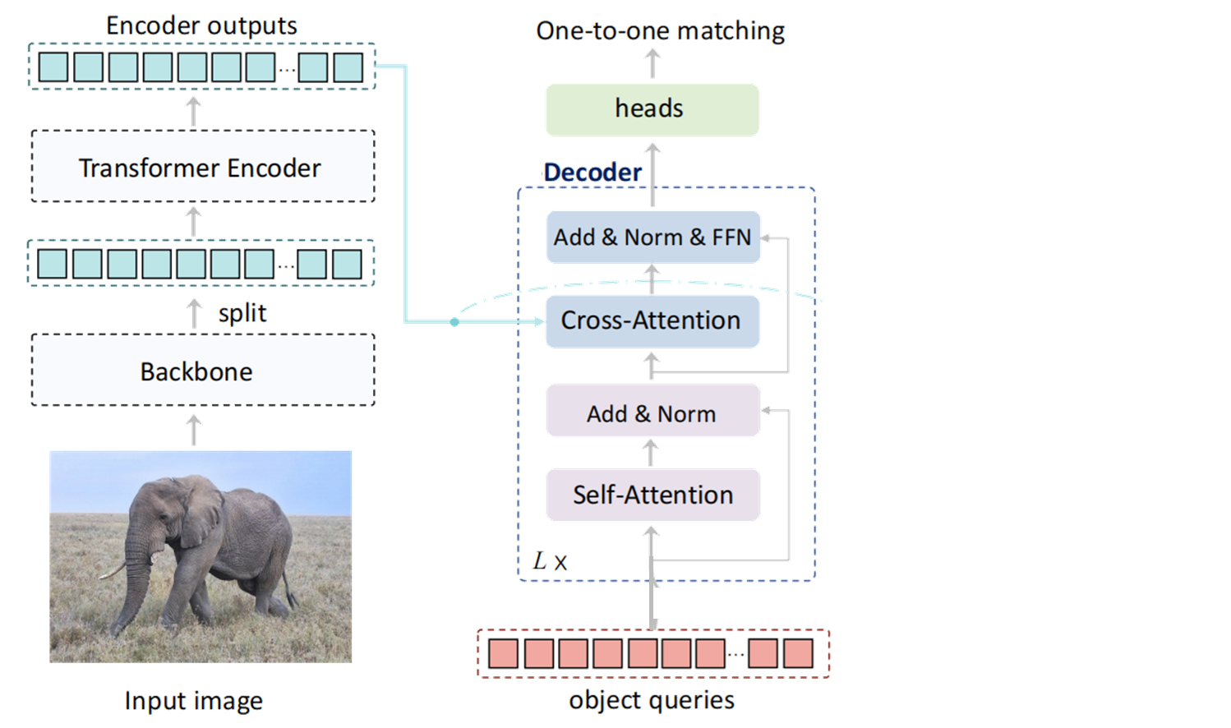
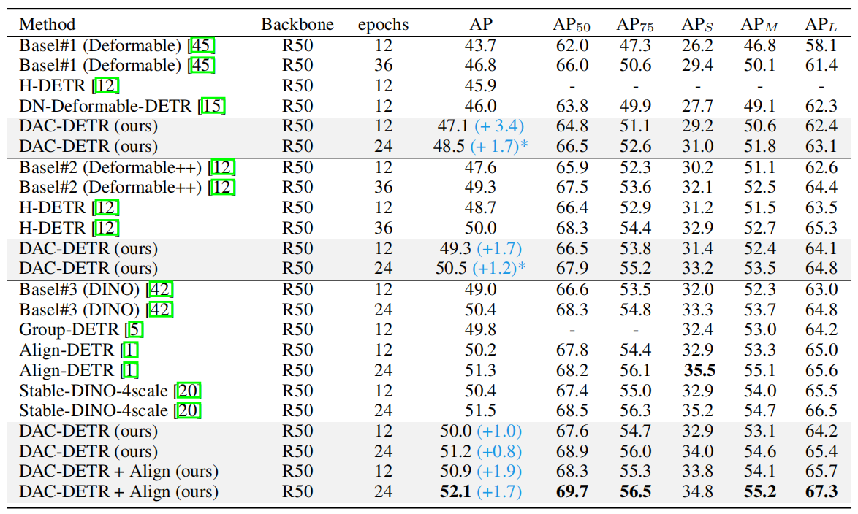
DAC-DETR: Divide the Attention Layers and Conquer

Slide 4
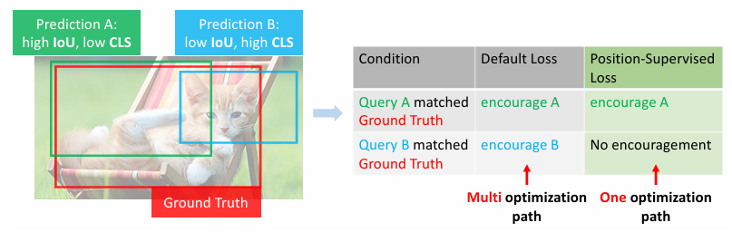
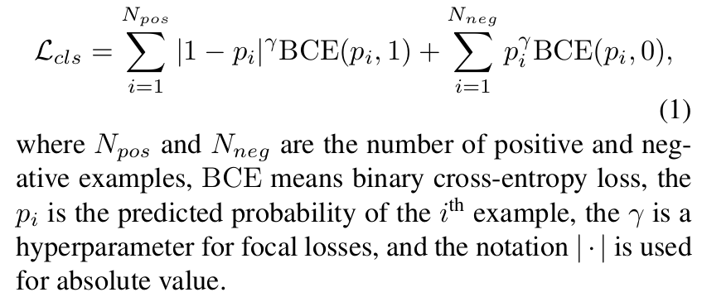
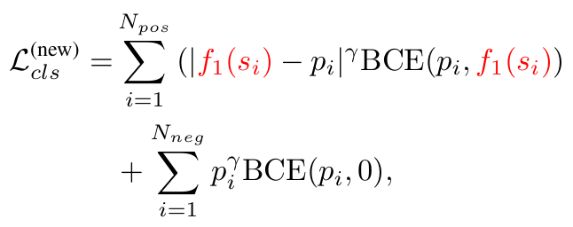
DAC-DETR: Divide the Attention Layers and Conquer
Task & Setting-To improve the training efficacy
1、Suppress the misalignment between the predicted probability and position through IoU-related loss function.
Liu S, Ren T, Chen J, et al. Detection transformer with stable matching[C]//Proceedings of the IEEE/CVF International Conference on Computer Vision. 2023: 6491-6500.

Slide 5
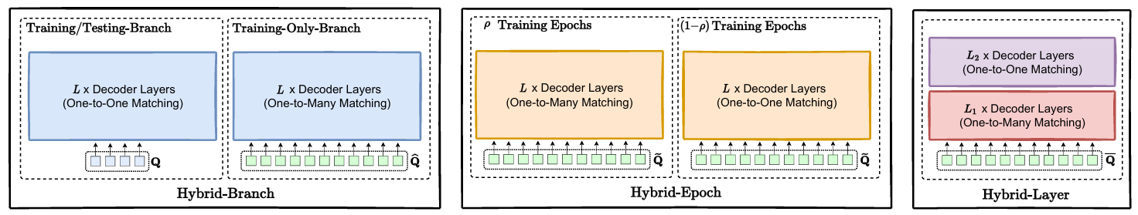
DAC-DETR: Divide the Attention Layers and Conquer
Task & Setting-To improve the training efficacy
2、To increase positive queries through additional one-to-many matching.
Jia D, Yuan Y, He H, et al. Detrs with hybrid matching[C]//Proceedings of the IEEE/CVF conference on computer vision and pattern recognition. 2023: 19702-19712.

Slide 6
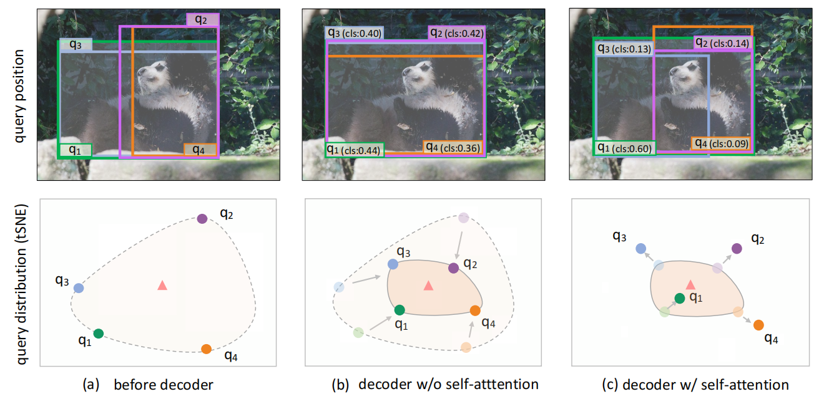
DAC-DETR: Divide the Attention Layers and Conquer
Motivation-To improve the training efficacy
rethink the cooperation between cross-attention and self-attention layers in the DETR decoder

Slide 7
DAC-DETR: Divide the Attention Layers and Conquer
Motivation-To improve the training efficacy

Slide 8
DAC-DETR: Divide the Attention Layers and Conquer
Motivation-To improve the training efficacy

Slide 9
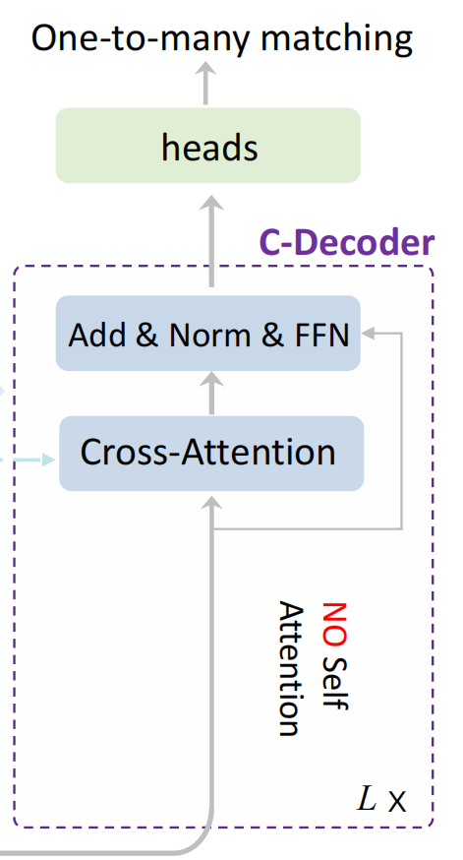
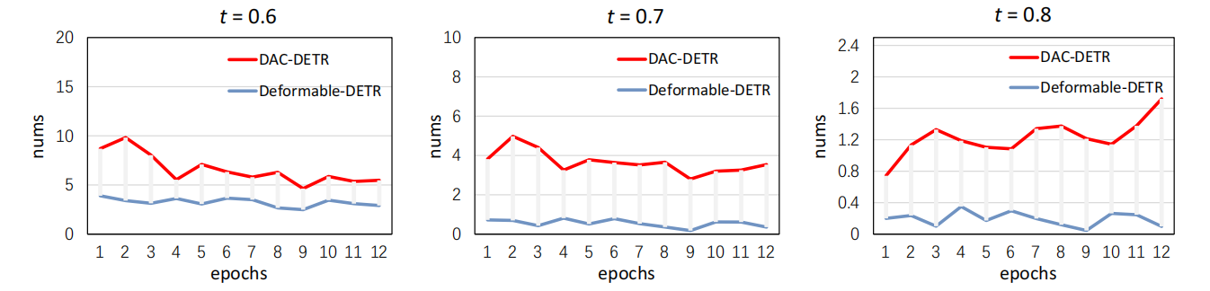
DAC-DETR: Divide the Attention Layers and Conquer
Method-delete self-attention layers & O2m match
Y-axis: avg num of queries per object
1、increase the number of queries gathered for each object
2、improve the quality of the best queries for each object.

Slide 10
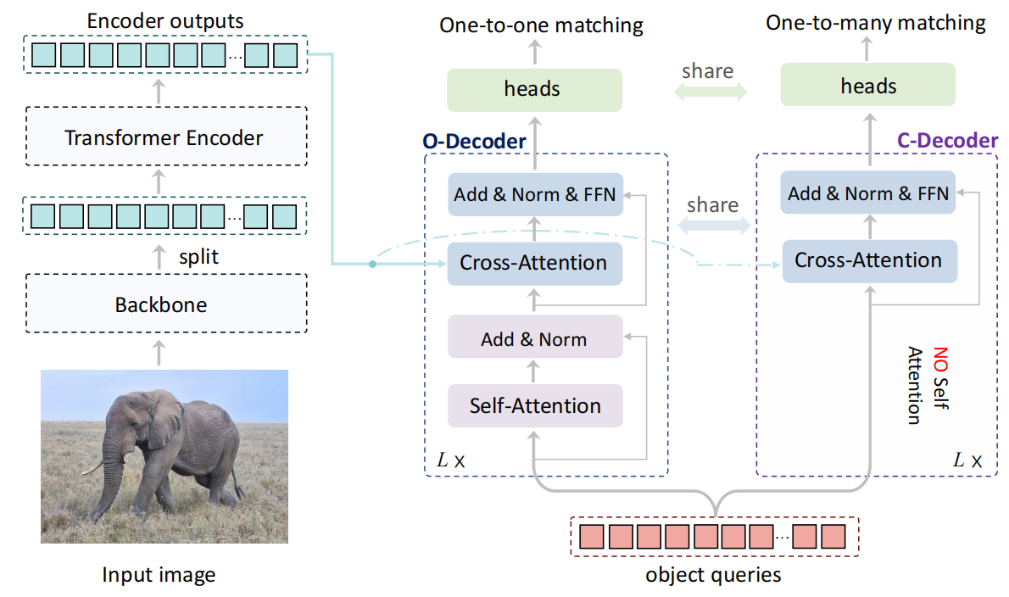
DAC-DETR: Divide the Attention Layers and Conquer
Method-framework

Slide 11
DAC-DETR: Divide the Attention Layers and Conquer
Experiments

Slide 12
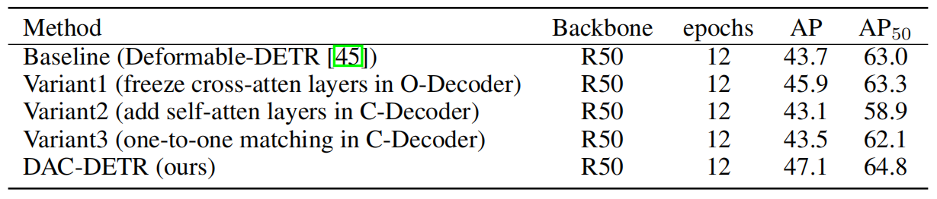
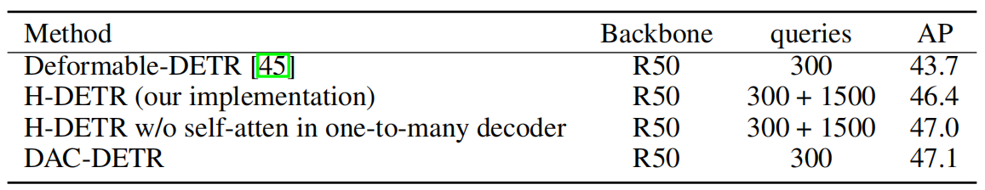
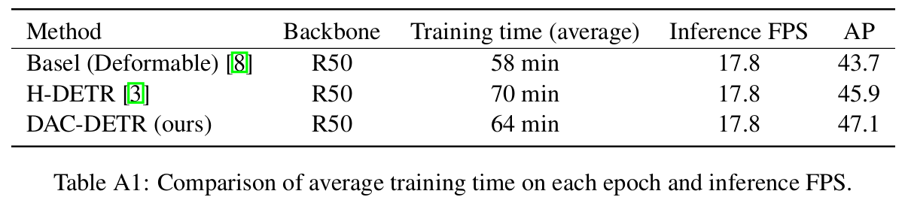
DAC-DETR: Divide the Attention Layers and Conquer
Ablation

Slide 13
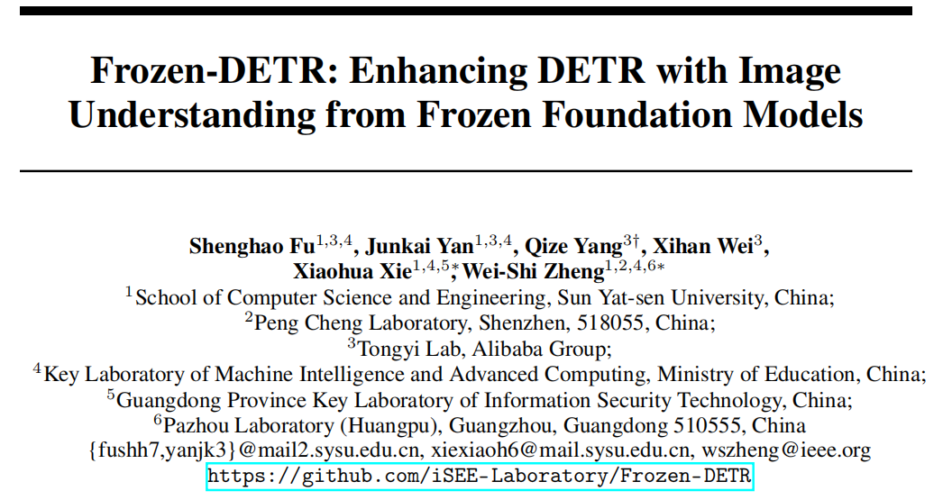
Frozen-DETR: Enhancing DETR with Image Understanding from Frozen Foundation Models

Slide 14
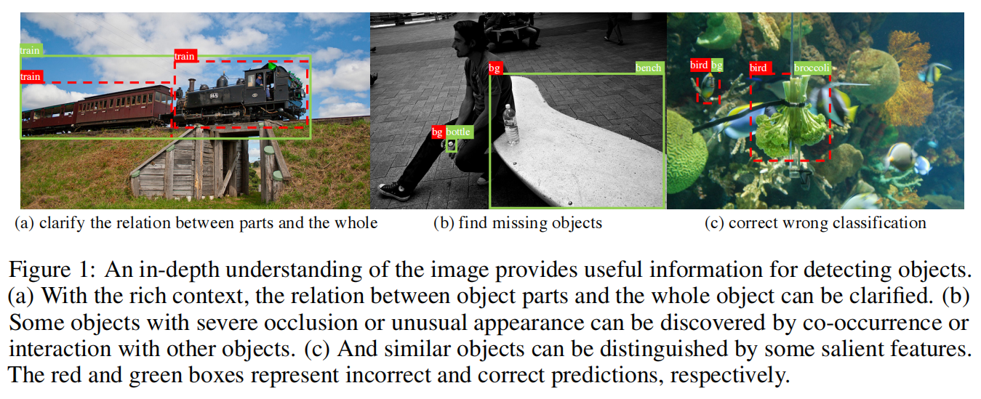
Frozen-DETR: Enhancing DETR with Image Understanding from Frozen Foundation Models
Task & Setting-the application of vision foundation models in object detection

Slide 15
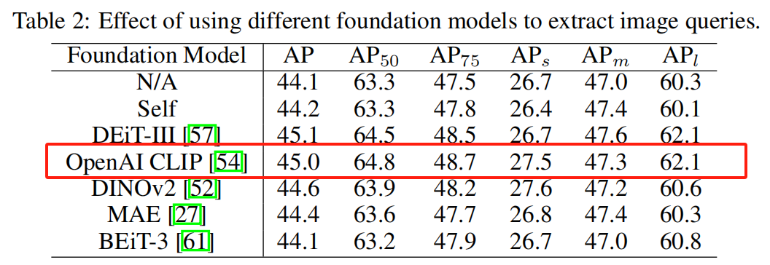
Frozen-DETR: Enhancing DETR with Image Understanding from Frozen Foundation Models
Method- foundation model
① CLIP 在大量的图像 - 文本对上训练。
② DINOv2 从大规模的图像集合中学习，能作为多用途backbone适用于许多不同的计算机视觉任务，如分类、分割、图像检索、深度估计等。
③ MAE 在如 ImageNet-1k 等大规模数据集上预训练，如视频模式的 VideoMAE、遥感图像模式的 Scale-MAE、点云模式的 Point-M2AE 等不同模式下的预训练基础模型。
④ BEIT-3 使用了包括约 1500 万张图片和 2100 万个图文对的多模态数据以及 1400 万张来自 ImageNet-21k 的图片和 160gb 的英文文本语料库等单模态数据进行预训练。

Slide 16
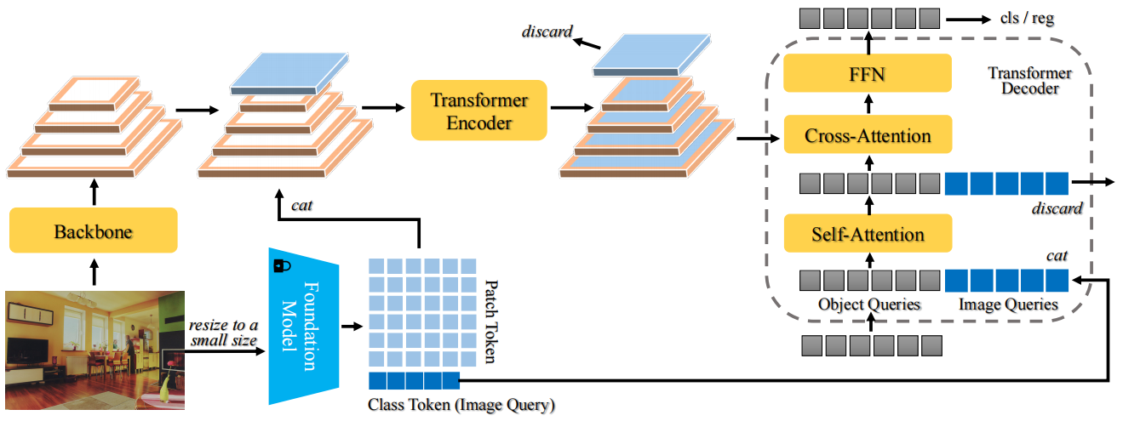
Frozen-DETR: Enhancing DETR with Image Understanding from Frozen Foundation Models
Method- not use foundation model as a backbone
1、take the class token as the full image representation, termed image query.
2、the fine-grained patch tokens with high-level semantic cues from foundation models are considered as another level of the feature pyramid.
3、The foundation model is parallel with the backbone and frozen during training.

Slide 17
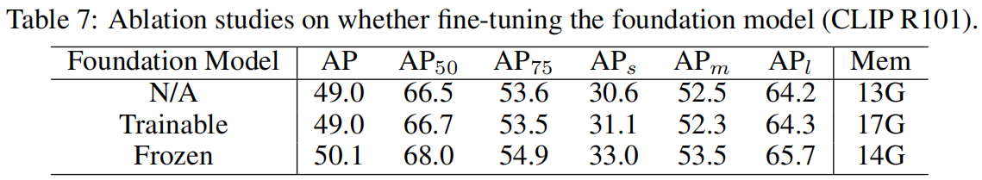
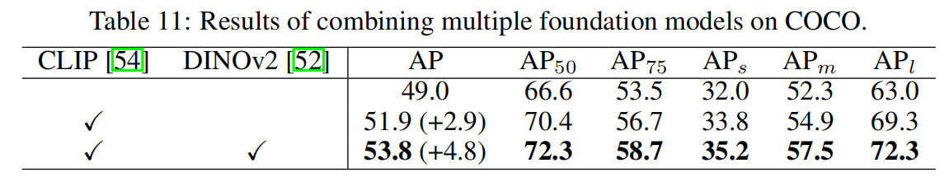
Frozen-DETR: Enhancing DETR with Image Understanding from Frozen Foundation Models
Method- foundation model

Slide 18
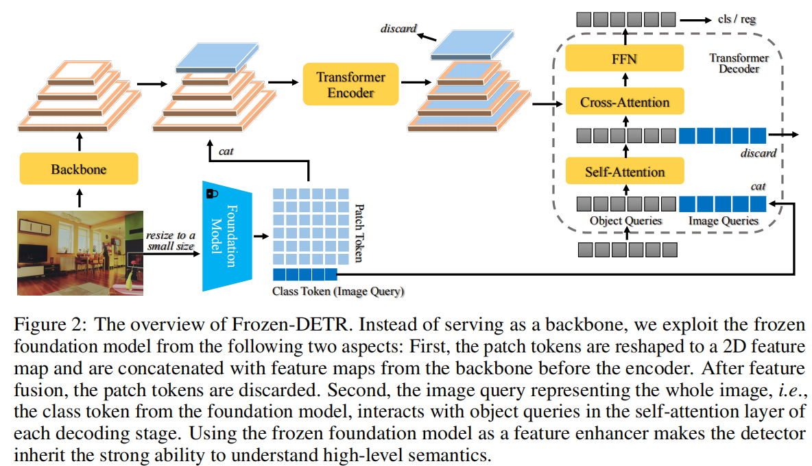
Frozen-DETR: Enhancing DETR with Image Understanding from Frozen Foundation Models
Method- not use foundation model as a backbone

Slide 19
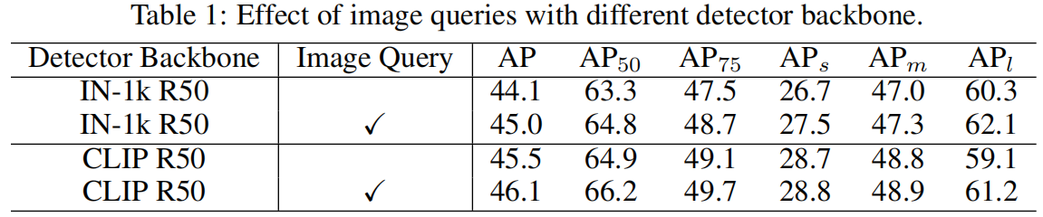
Frozen-DETR: Enhancing DETR with Image Understanding from Frozen Foundation Models
Method-image query
Different from conventional object queries whose content vector represents a single object and the position vector is the bounding box of the object,
the image query represents the whole image, and its box is the full image boundary.
Img_queries num | AP
0 | 44.1%
1 | 45.0%
1+4 | 45.8%
1+4+9 | 45.6%

Slide 20
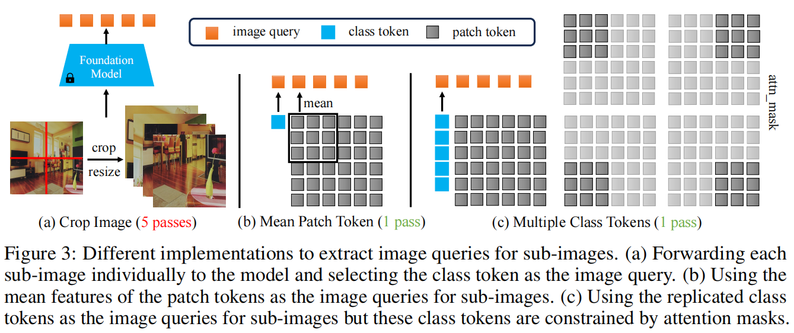
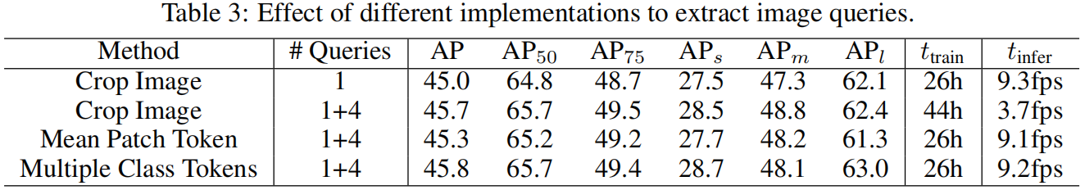
Frozen-DETR: Enhancing DETR with Image Understanding from Frozen Foundation Models
Method-image query

Slide 21
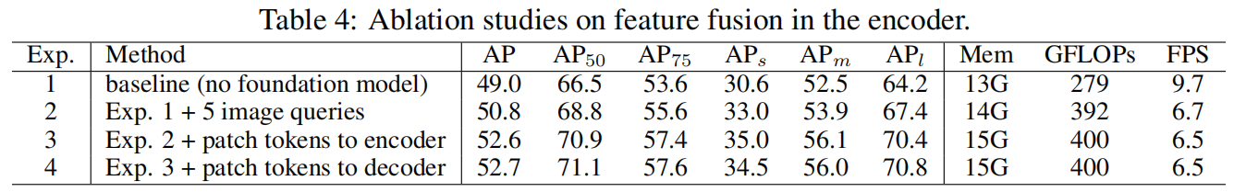
Frozen-DETR: Enhancing DETR with Image Understanding from Frozen Foundation Models
Method-feature fusion

Slide 22
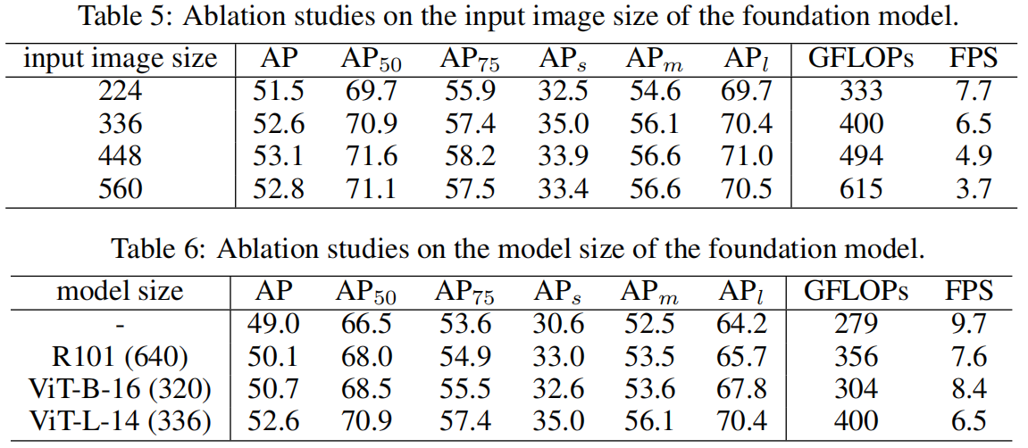
Frozen-DETR: Enhancing DETR with Image Understanding from Frozen Foundation Models
Method-feature fusion

Slide 23
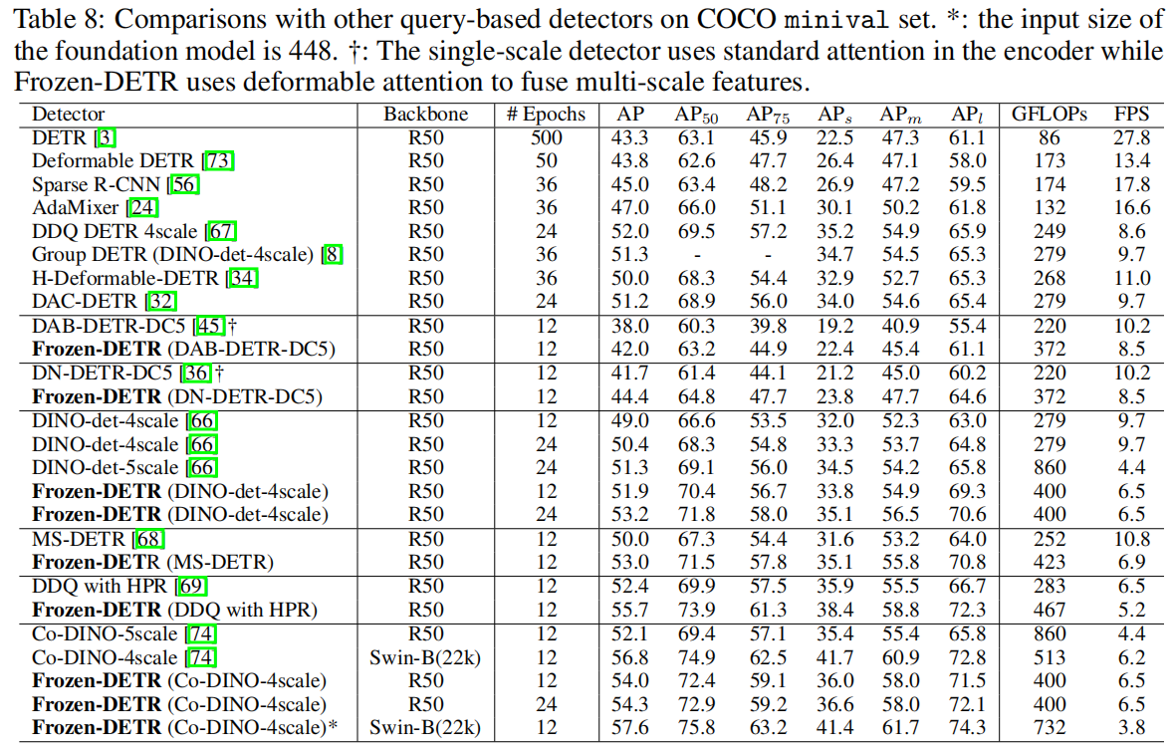
Frozen-DETR: Enhancing DETR with Image Understanding from Frozen Foundation Models
Experiment

Slide 24
Seminar-DETR Series
马鸣霄
2025.01.03

